Slide 1
Course: Professional Issues in IT
Course Instructor: Kashan Hussain
Email address: Kashan.Hussain@nu.edu.pk
Lec # 9

Slide 2
Financial Accounting
After studying this chapter, you should understand the purpose of the three most important items in the annual report:
the balance sheet;
the profit and loss account; and
the cash flow statement.
These are known as the financial statements and together they provide a picture of the overall financial health of the business. You should be able to interpret them in simple cases.

Slide 3
Annual Report
The limited companies, when liquidify, only looses the amount they have spent. How ever there is a check on the performance of these companies.
In UK the law requires that, every year, the company produces an annual report, which must be filed at Companies House.
In Pakistan the companies submit these reports to the license providing authority namely SECP; Securities and Exchange Commission of Pakistan .
The annual report contains information about the company and its activities during the preceding year.
Link: https://www.secp.gov.pk/
Notes:
Need of annual report.

Slide 4
THE BALANCE SHEET
The balance sheet is that financial statement in the annual report which show
what the company owns – its assets
and what it owes – its liabilities.
Key words
Current Assets
Fixed Assets
Depreciation
Tangible
Intangible
Current liabilities
Fixed liabilities
Notes:
Tangible physical present
Intangible not physically (copyrights , brand name)

Slide 5
Current Assets
Current assets are assets that can be converted into cash within one fiscal year or one operating cycle. Current assets are used to facilitate day-to-day operational expenses and investments. As a result, short-term assets are liquid, meaning they can be readily converted into cash.
Examples of current assets include:
Cash and cash equivalents, which might consist of certificates of deposit
Marketable securities, such as equity or debt securities
Accounts receivable, or money owed to the company for selling their products and services to their customers
Inventory
Prepaid expenses

Slide 6
Fixed Assets
Fixed assets are noncurrent assets that a company uses in its production of goods and services that have a life of more than one year. Fixed assets are recorded on the balance sheet and listed as property, plant, and equipment (PP&E). Fixed assets are long-term assets and are referred to as tangible assets, meaning they can be physically touched.
Examples of fixed assets include:
Vehicles like trucks
Office furniture
Machinery
Buildings
Land

Slide 7
Tangible vs Intangible Assets
Tangible assets are physical items owned by a company, such as equipment, buildings, and inventory.
Tangible assets are the main type of asset that companies use to produce their products and services.
Intangible assets are nonphysical items that have a monetary value because they represent potential revenue.
Intangible assets include patents, copyrights, and a company's brand.
Notes:
Tangible Assets vs. Intangible Assets: What's the Difference? (investopedia.com)

Slide 8
Current liabilities are usually considered short-term. They're expected to be concluded within 12 months or less.
Non-current liabilities are long-term. They're expected to last 12 months or longer.
It might signal weak financial stability if a company has had more expenses than revenues for the last three years because it's been losing money for those years.

Slide 9
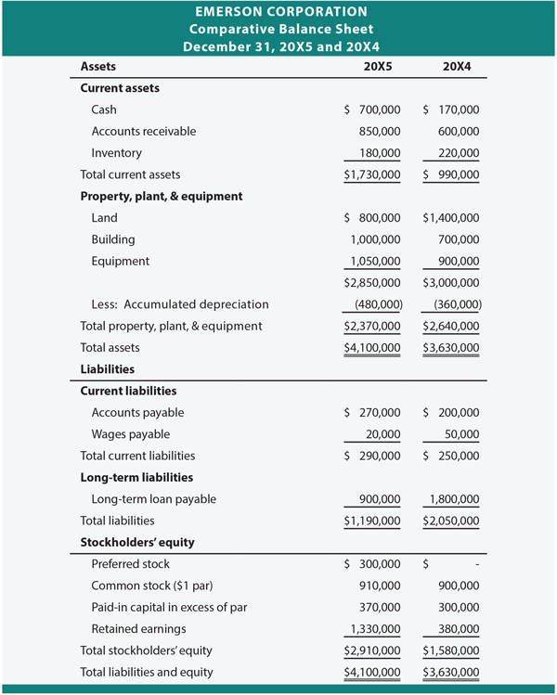
Balance Sheet
Notes:
DEFINITION of 'Stockholders' Equity'
The portion of the balance sheet that represents the capital received from investors in exchange for stock (paid-in capital), donated capital and retained earnings. Stockholders' equity represents the equity stake currently held on the books by a firm's equity investors.
It is calculated either as a
firm's total assets - its total liabilities,
or as
share capital + retained earnings - treasury shares
Also known as "shareholders' equity".

Slide 10
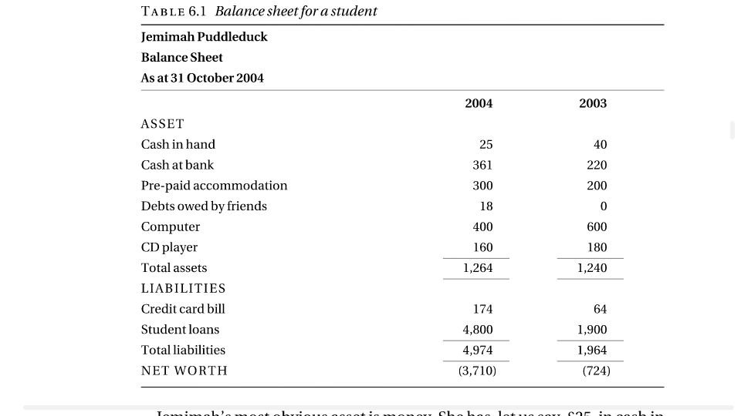
Balance sheet

Slide 11
THE PROFIT AND LOSS ACCOUNT
The profit and loss account shows how much money has been received and how much has been spent in a given period – usually the organization’s financial year.
In the case of non-profit-making organizations it is usually called an income and expenditure account.

Slide 12
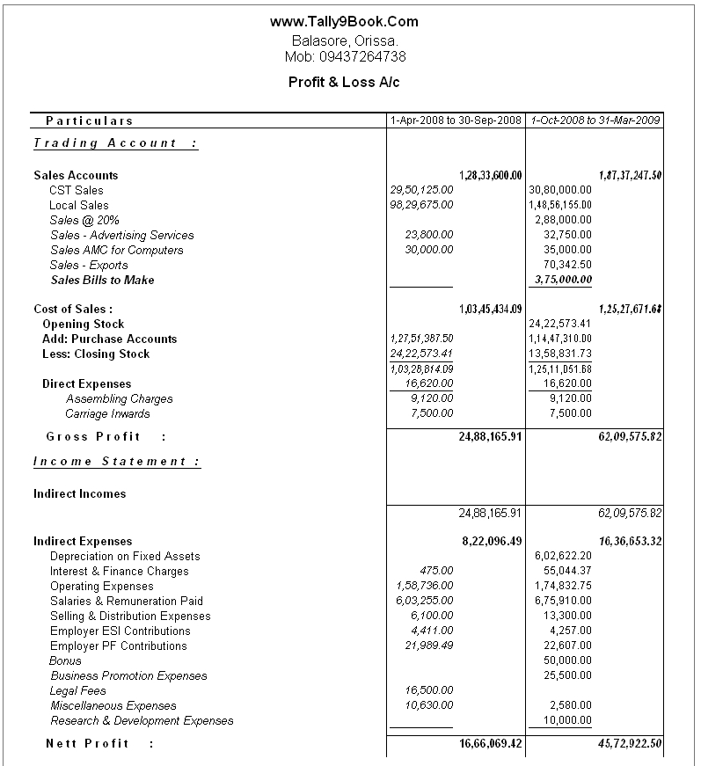
Profit and Loss Account

Slide 13
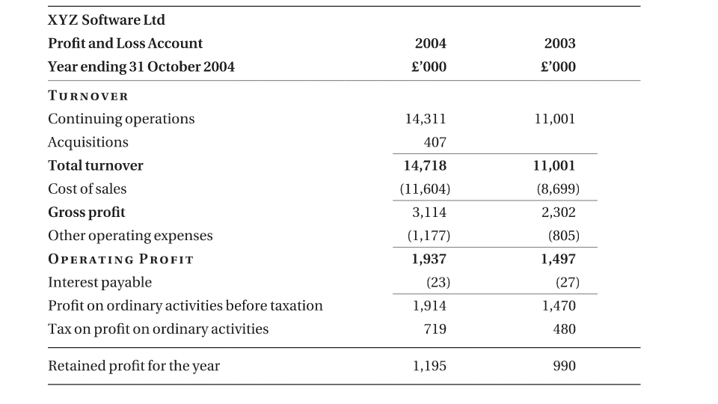
Profit loss account
Notes:
Meaning of turn over in the context of Finance: The volume or value of shares traded on a stock exchange during a day, month, or year.

Slide 14
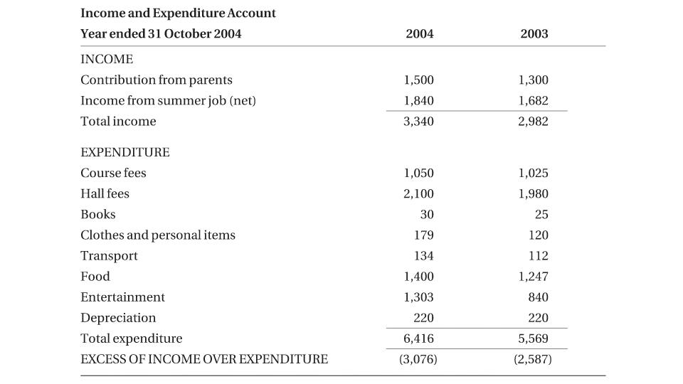
Income expenditure account

Slide 15
THE CASH FLOW STATEMENT
Parents usually investigate about the expenses of their kids. Often during childhood we were asked for where we spent our money. If we bought any thing we were asked from where did the money come.
Thus creating a flow “from where to where” these accounts show cash flow.
The link that ties the balance sheet and the profit and loss account to the capital expenditure is the cash flow statement.

Slide 16
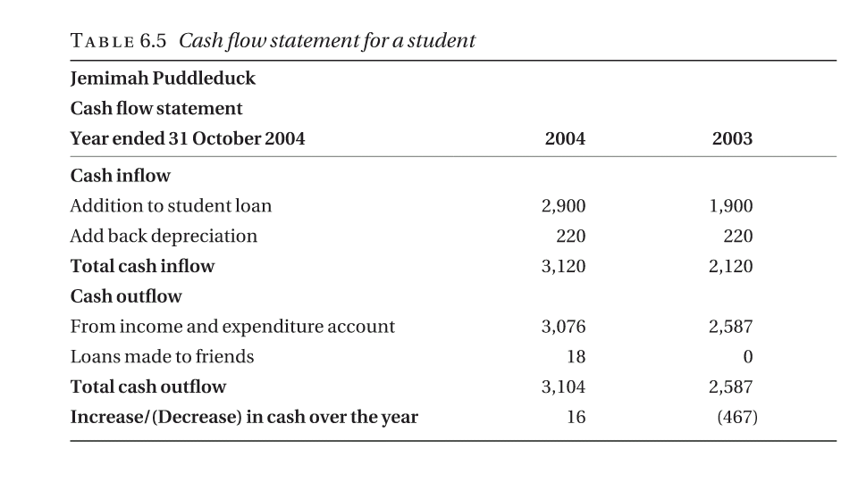
Cash flow

Slide 17
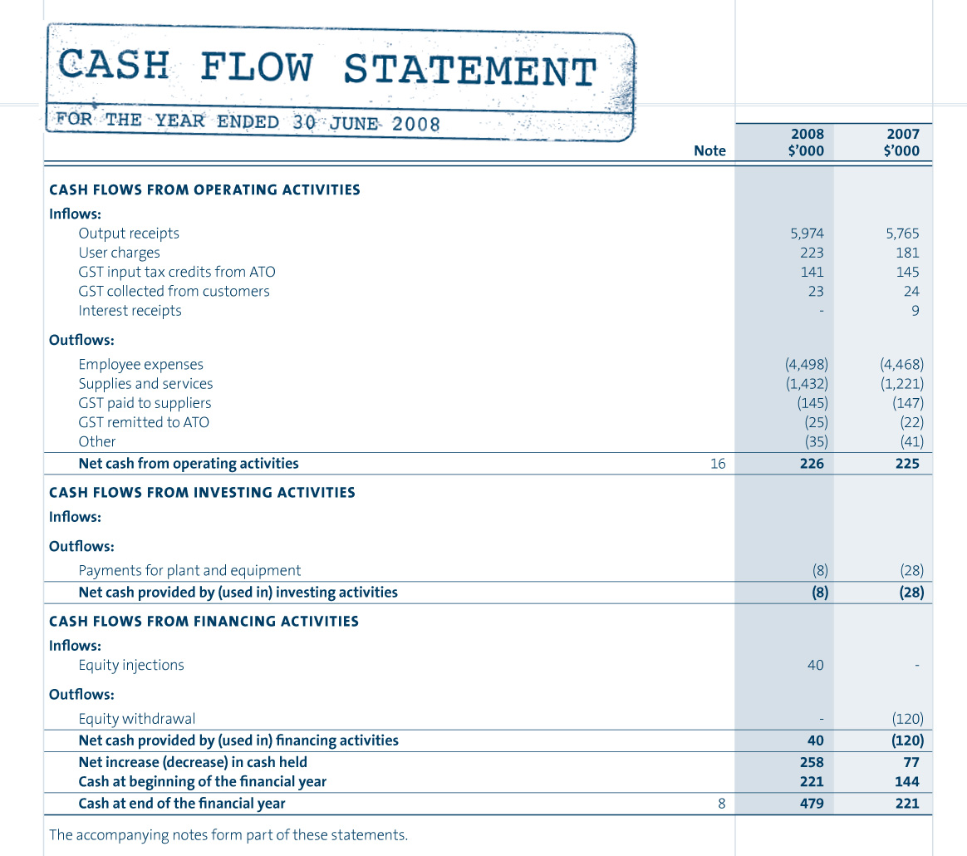
Cash Flow

Slide 18
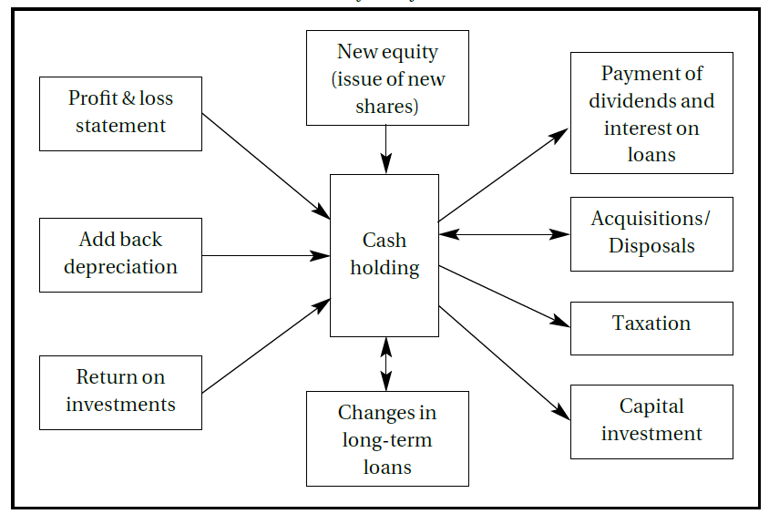
Sources and destinations of cash flows

Slide 19
THE OVERALL PICTURE
The balance sheet, the profit and loss account, and the cash flow statement can none of them be understood or interpreted in isolation. Their relationship to each other needs to be understood and they need to be looked at together when assessing the financial state of a company.

Slide 21
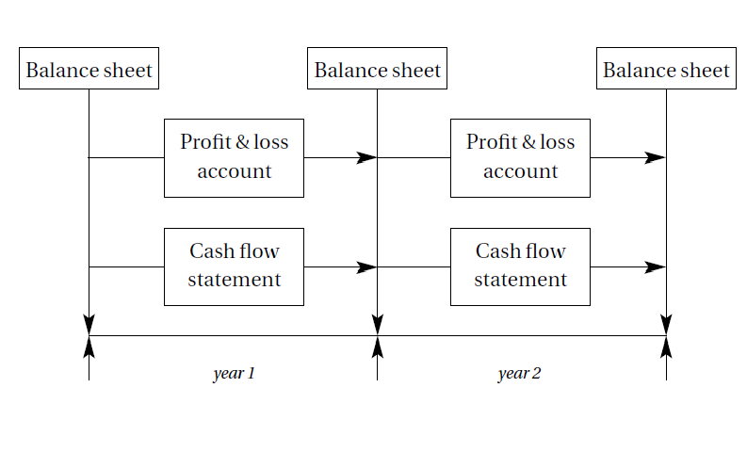
The relationship between the three financial statements

Slide 22
Some questions
What is the difference between current assets and non-current assets?
Which financial statement can I find noncurrent assets on?
On which financial statements does a company report its long-term debt?
What items on the balance sheet are most important in fundamental analysis?
What are some common examples of noncurrent assets?

